Slide 1
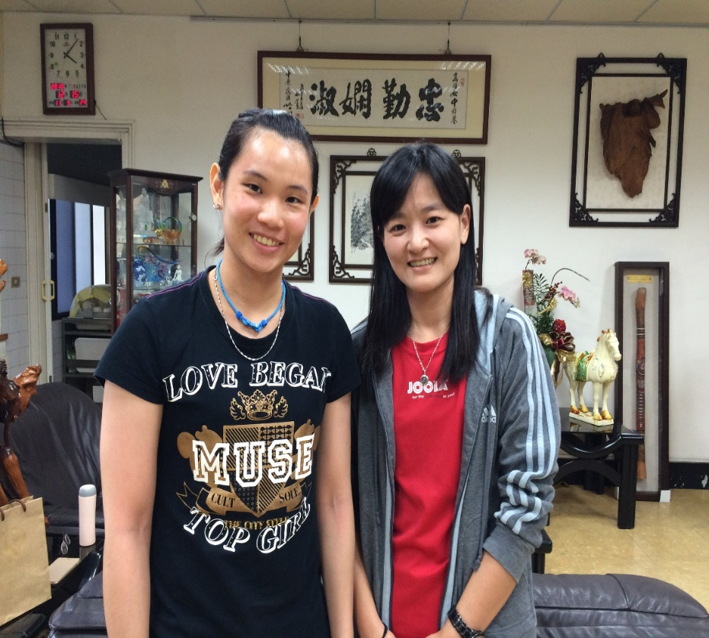
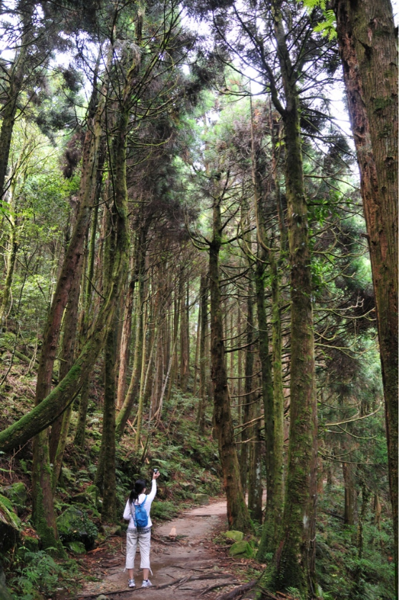
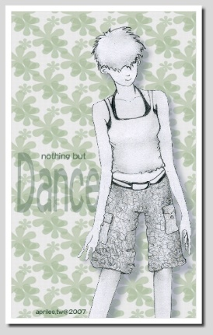
Li chiachin 李嘉瑾
My Hobboies
Badminton
I love Trees
Drawing

Slide 2
Li chiachin SELF INTODUCTION
About Me
My Interests
Daily Life
Culture Box
Daily Life
About Me
My Interests
CultureBox

Slide 3
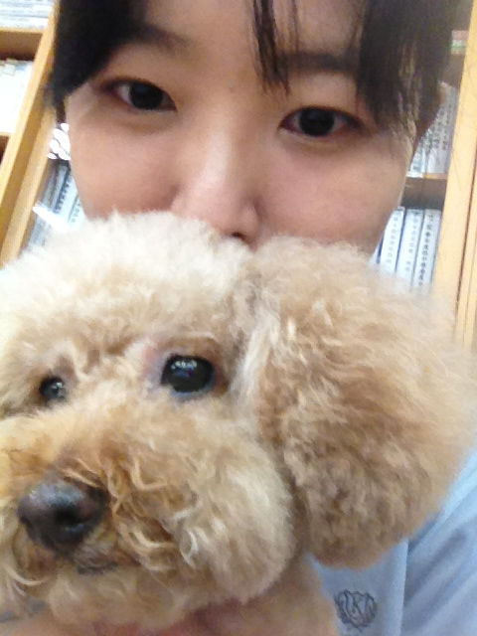
Li chia chin About Me

Slide 4
My Interests
I love Badminton
Badminton
I love Trees
Drawing

Slide 5
Daily Life
Play Tennis with my friends
Walk
my
Dogs

Slide 6
Culture Box
Hakka Pattern
Ask for God’s Favor

